Slide 1

Simple Contact Management System

Slide 2

Supervised by:
M. M. Fazle Rabbi
Assistant professor
Department of Computer Science and Engineering
(BUBT)
Submitted by:
Mohammad Sabbir Ahmed (ID:17183103004)
Rakibul Ahasan (ID:17183103022)
Sk. Abu Hanif (ID:17183103043) Intake-39 (section-1)
Dept. of Computer Science and Engineering

Slide 3
CONTENT
Introduction
Problem Statement
Motivation
Objectives
Software and Hardware requirements
Use case Diagram
Flow chart
Conclusion
Future Plan
Simple Contact Management System

Slide 4
Introduction
The simple contact management system is an automated version of phonebook Application system.
User can store detail contact information of a person easily using this application.
This application is developed by using only C language.
Simple Contact Management System

Slide 5
Problem Statement
Proper security.
Mobile number validation.
Telephone number validation.
Email address validation.
Searching contact using various entity.
Simple Contact Management System

Slide 6
MOTIVATION
There are some lacking's in so called contact application used by people around us.
Those application can’t confirm the validity of the mobile number or email address which was listed by the user.
There is no encrypted password protected system in so called contact application.
They can’t search contacts by a particular area, name address or any other entity.
Simple Contact Management System

Slide 7
OBJECTIVE
The main objective of this project is to solve those features which are not available to so called contact application:
Protecting the application with encrypted password.
Notifying the user if the mobile number or email address is invalid.
Searching a contact using a particular entity.
Simple Contact Management System

Slide 8
SOFTWARE AND HARDWARE RECQUIREMENT
Software:
Windows XP or letter operating system.
CodeBlocks
Hardware:
Ram : Minimum 512 mb.
Simple Contact Management System

Slide 9
USE CASE DIAGRAM
User
Add a contact
Delete Contact
Edit contact
Search for Particular contact
Simple Contact Management System

Slide 10
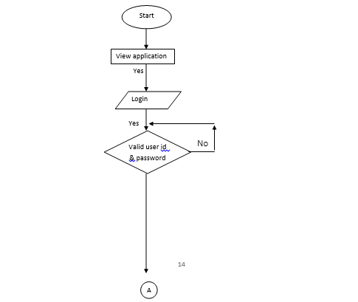
FLOW CHART
Simple Contact Management System

Slide 11
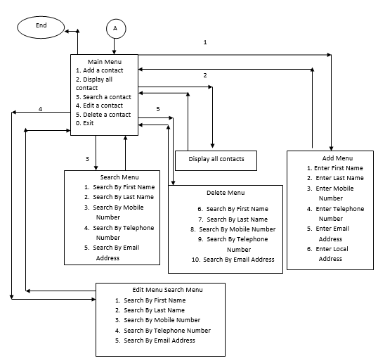
FLOW CHART
Simple Contact Management System

Slide 12
CONCLUSION
We tried our best to built a best contact management system, though we faced many problem.
The storage size of the system is not dynamic.
The system is not well decorated with graphical decoration.
Simple Contact Management System

Slide 13
FUTURE PLAN
Building a mobile application.
Adding a free live chatting option for the users.
Connect this application to cloud storage system.
Adding a map to the application.
Adding eye catchy graphics.

Slide 14
Thank You!
Simple Contact Management System

